Slide 1

Airline Safety Information
The truth behind overall safety even after recent events

Slide 2
What they are saying
The Media
The Public
Fixing the Problem
Media says flying is no longer the safest mode of transportation.
Media keeps showing the recent crashes and numbers that are misleading.
Public has been down on flying since COVID-19.
Now with these recent problems, public opinion is lower than ever.
Interest in flying is dropping quickly.
We need to put out actual information that tells the true story behind flight safety.
Changing the media’s mind will transfer down to the public. Start there!

Slide 3
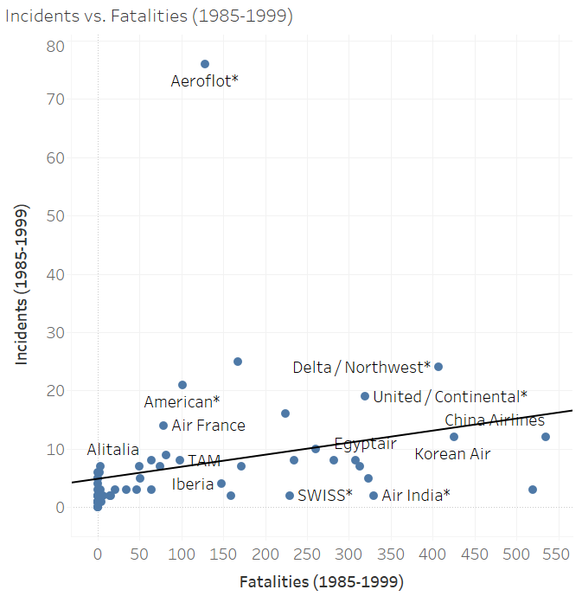
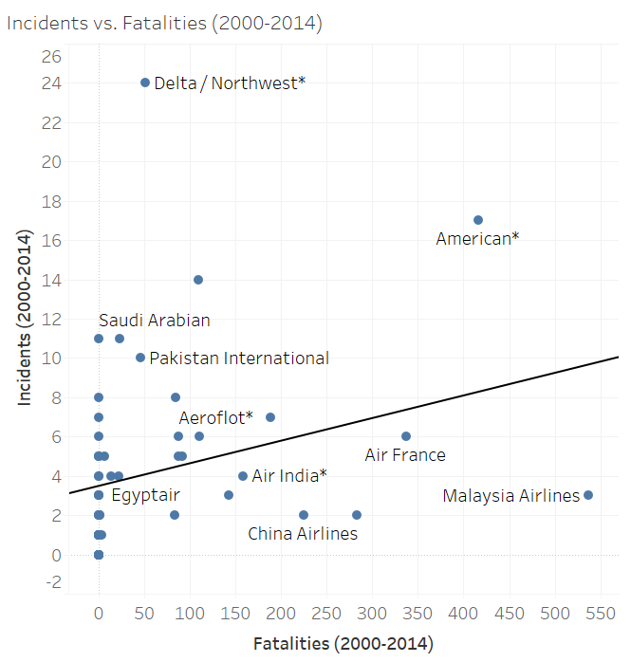
Increases in airline safety
The most decent 15 years have been significantly safer than the 15 years prior. Total incidents dropped nearly in half from 7.18 incidents per airline to 4.125.

Slide 4
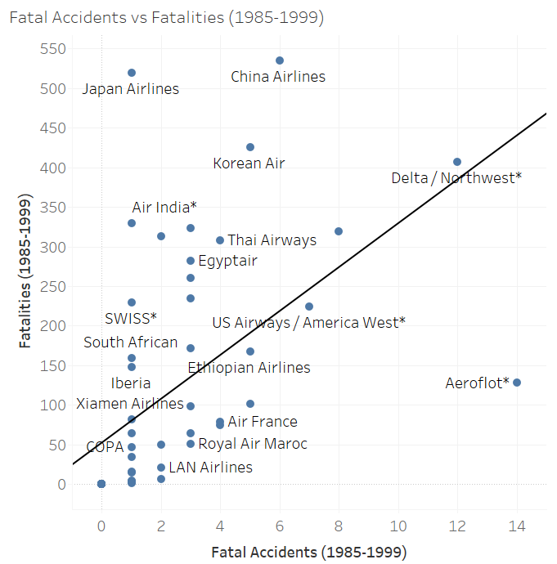
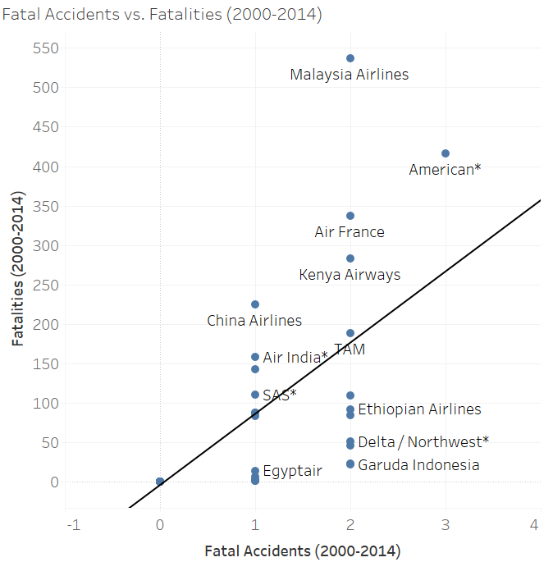
Increases in airline safety
Both fatalities and fatal accidents have dramatically fallen between the two 15-year periods. The average fatal accidents dropped from 2.17 per airline to 0.66 and fatalities dropped from 112 per airline to 55.5.

Slide 5
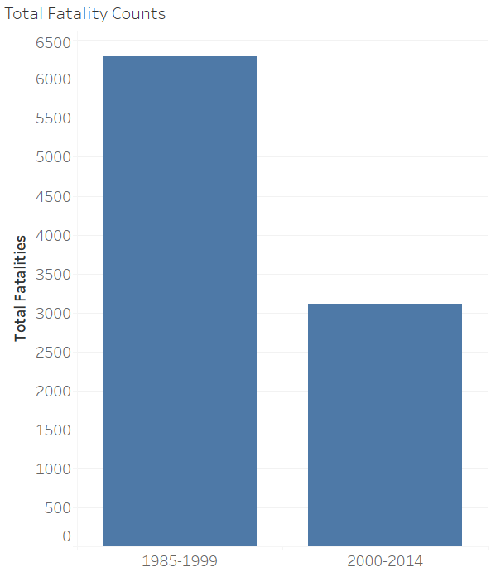
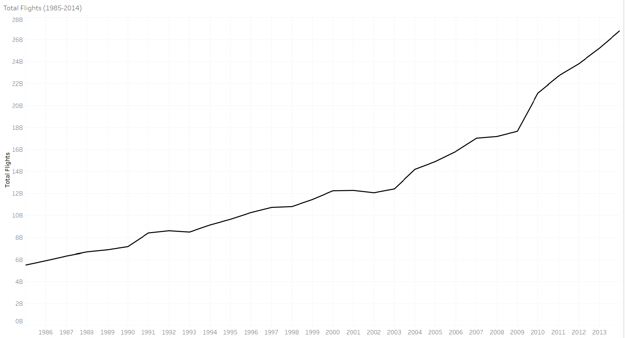
Increases in airline safety
We have seen the decreases in incidents and fatalities, all while there has been an increase in the number of flights and number of people per flight.

Slide 6
Rundown of the Numbers
1985-1999 | 2000-2014
Average Incident per Airline: 7.18 | Average Incident per Airline: 4.125
Average Fatal Accidents per Airline: 2.18 | Average Fatal Accidents per Airline: 0.66
Average Fatalities per Airline: 112.41 | Average Fatalities per Airline: 55.52
Average Flights per Year: 8,400,371,450 | Average Flights per Year: 17,701,713,053
Flying is not more dangerous than before, it is actually the opposite. All metrics are falling drastically despite the fact that the number of flights is rising. During our timeframes, flights more than doubled while nearly all negative outcomes were halved.

Slide 7
Our Next Steps

Slide 8
Changing Perceptions
11.01.XX
The Media | The Public
Provide them with the earlier facts, that flying has never been safer and is still the safest way to travel. Show them that airline safety is still our number one concern even with the recent crashes. Show the numbers and prepare for news outlets to reach out for questions and interviews. Don’t back out of these opportunities to show the facts and stop media from misleading the public. | By speaking with media, we should reach the public with these numbers as well. Work on an ad campaign both for our company and the airline industry as a whole to show that safety is the most important aspect of flying and getting people where they need to go. Keep prices lower to incentivize keeping our seats full and weather the storm. If all else fails, the media will find a new story and people will soon forget.

Slide 9

What we need to do
Although historical data is on our side and flying is safer than ever, we need to stay up-to-date on these recent crashes and do everything in our power to prevent the issues.
Make sure to support both our company and the industry as a whole. Competitors or not, we all suffer if people don’t trust flying.
Although we could weather the storm and wait for people to forget, this is a good chance to be proactive about it and get ahead of the issue. If we can show that flight safety is getting better year by year AND can show our crash statistics, this turns into an ad for the industry as well as us.

Slide 10
“Crash Free since 2004*”

